Slide 1
Kinematics Vocabulary
Units and vectors and scalars, oh my!

Slide 2
t: time
s (second) {alt. min, hour, year}
scalar
No formula (fundamental measurement)
When?
One clock reading

Slide 3
x: position
m (meter) {alt: inch, foot, mile…}
vector
No formula
Where?
Location relative to origin – or ZERO position

Slide 4
Δt: duration
s (second) {alt. min, hour, year}
scalar
Δt = t_{f} - t_{i}
How long?
Change of time, elapsed time, period of time

Slide 5
Δx: displacement
m (meter) {alt. foot, mile, etc}
vector
Δx = x_{f} - x_{i}
How far and which way from start position?
Change of position

Slide 6
d: distance
m (meter) {alt. foot, mile, etc}
scalar
d = total length of path
How far?
Total size of path traveled

Slide 7
S_{avg}: Average Speed
m/s (meters per second) {alt. mile/hour}
scalar
S_{avg}= d / Δt
How fast?
Average rate of distance traveled

Slide 8
v_{avg} Average Velocity
m/s (meters per second) {alt. mile/hour}
vector
v_{avg}= Δx / Δt
v_{avg}= slope of (secant) line on x vs t graph
How fast and which way (has the object been moving)?
Average rate of change of position

Slide 9
v: (Instantaneous) Velocity
m/s (meters per second) {alt. mile/hour}
vector
v = slope of (tangent) line on x-t graph
How fast and which way (is/was the object moving at a certain time)?
Rate of change of position at a given time
NOTE: When velocity is constant, the velocity at every instant is the same as the average velocity for the interval

Slide 10
S: (Instantaneous) Speed
m/s (meters per second) {alt. mile/hour}
scalar
S= |v|
How fast?
Rate of distance traveled at a certain time
NOTE: When velocity is constant, the speed at every instant is the same as the average speed for the interval

Slide 11
m/s/s OR m/s² (meters per second squared) {alt. feet per second squared}
vector
? = Δv / Δt
How quickly and which way the velocity changes?
Average rate of change of velocity

Slide 12
a: (Average ) Acceleration
m/s/s OR m/s² (meters per second squared) {alt. feet per second squared}
vector
a_{avg}= Δv / Δt
How quickly and which way the velocity changes?
Average rate of change of velocity
NOTE: We will limit our study of motion to situations where the acceleration is CONSTANT

Slide 13
Relationships
Acceleration is to velocity as _____________ is to ________________
Zero velocity means constant _____________
Constant velocity means zero _____________

Slide 14
Kinematics Terms and Graphs
Type of Graph | Examine, or determine the values of the coordinates of one point on the graph… | Calculate the slope, or determine any trends with the slope…
position vs time | You will know the position of an object at a given time; knowing this for two points on a graph enables you to compute slope. | You will know the velocity, or know if the velocity is constant, increasing or decreasing
velocity vs time | You will know the velocity of an object at a given time; knowing this for two points on a graph enables you to compute slope. | You will know the acceleration, or know if the acceleration is constant, or not

Slide 15
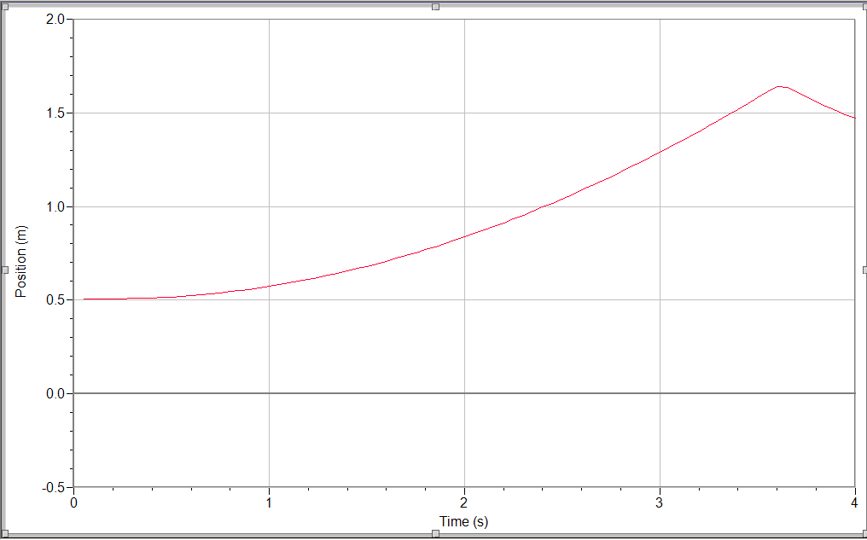
Kinematics Terms and Graphs

Slide 16
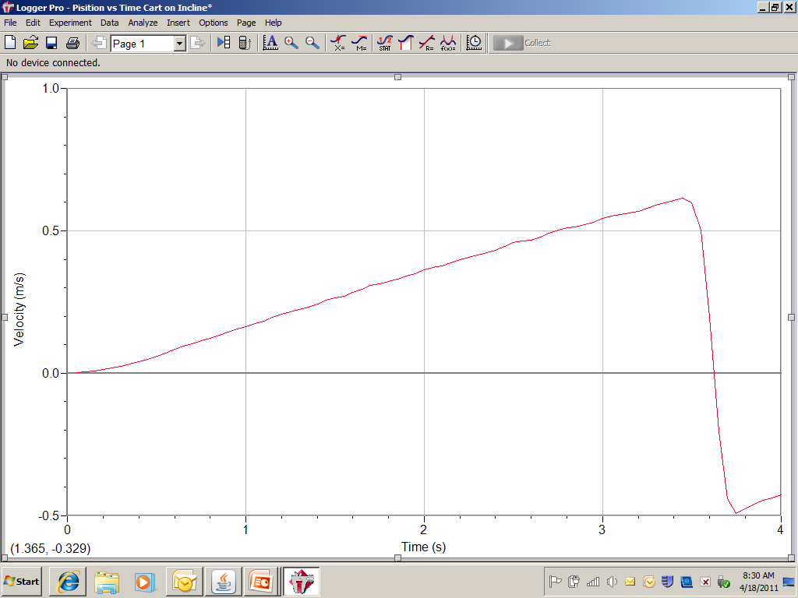
Kinematics Terms and Graphs

Slide 17
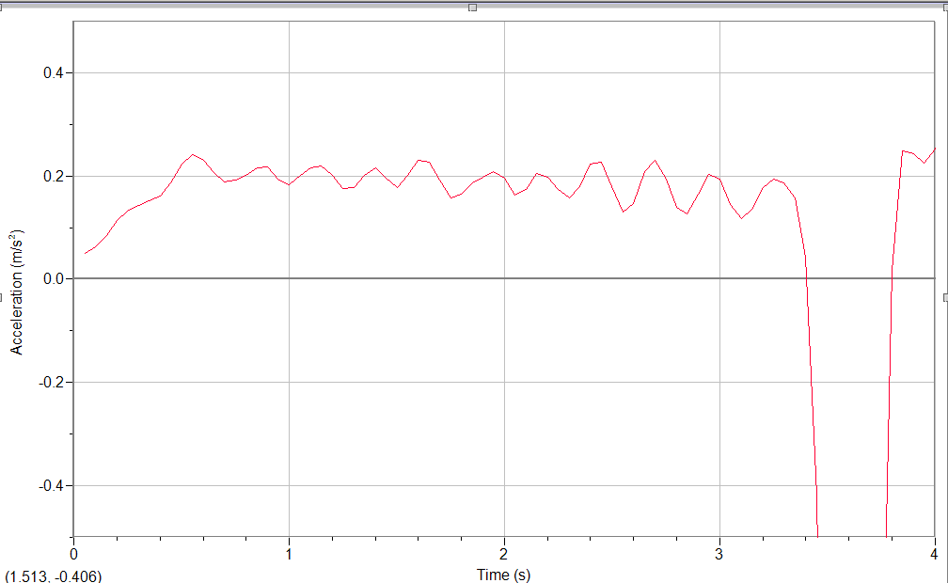
Kinematics Terms and Graphs

